Slide 1


H.R. 1: What Partners and Providers Need to Know
Preparing Frontline Staff for AHCCCS Work Requirements & 6-Month Renewals
*For Year 1 implementation

Slide 2
Why This Matters
Your staff may be the first point of contact for members with questions.
This training will help your team give accurate, consistent answers.
Starting January 1, 2027,
federal law requires AHCCCS to implement work requirements and 6-month renewals for some adults ages 19–64 who are enrolled in the adult group.

Slide 3
What's Changing
Work Requirements
Many adults ages 19–64 will need to meet new work requirements or qualify for an exemption.
6-Month Renewals
Many adults ages 19–64 will also need to renew their AHCCCS coverage every 6 months instead of once a year.

Slide 4
What Members Should Know
Most AHCCCS members are NOT impacted.
AHCCCS will let members know if these changes apply to them.
Members do not need to do anything until they receive specific instructions from AHCCCS about their own case.

Slide 5
Who Is Impacted
These changes only apply to the adult group. The adult group covers individuals who are:
Ages 19–64
Don’t have Medicare
Don’t qualify for other AHCCCS coverage groups (e.g., ALTCS)
Have income up to $1,769/month for an individual or $3,658/month for a family of four

Slide 6
How Members Can Meet Work Requirements
A
Have an income of at least $580/month
B
Complete 80 hours/month of any of the following qualifying activities per month, or a combination of them: Working (paid or unpaid), going to school, job training or work program, community service or volunteering
C
A combination of both (some income and some hours of qualifying activities)

Slide 7
What Income Counts?
The following are examples of income that count towards the $580 monthly income:
  Income from a job
  Gig work income
  Self-employment income
  Tips
  Unemployment compensation
  Social Security Income
  Social Security Disability Income (SSDI)
  Retirement or pension income
  Capital gains
  Investment income
  Rental and royalty income
For a complete list, please see AHCCCS’ Eligibility Policy Manual

Slide 8
Whose Income Counts?
AHCCCS will follow federal guidelines for Modified Adjusted Gross Income (MAGI).
The counted income of the MAGI household is used to determine if an individual meets the $580 income for work requirements.
Therefore, if two individuals subject to work requirements are in the same MAGI household, then their total household income will be used to determine compliance with the requirements.
EXAMPLE:
Dan and Jessica are married and are both part of the adult group.
Dan has an income of $350 a month, and Jessica has an income of $450 a month.
Together they have an income of $800 a month.
$800 > $580 = both meet
work requirements!

Slide 9
Qualifying Activities: Work and School (1 of 2)
Work includes:
Half-time or full-time educational programs include:
Employment, including gig work
Self-employment
Independent contractor work
Unpaid work, such as unpaid internships or working in exchange for goods or services
Institution of higher education (college or university)
Program of career and technical education
High school
State approved program of study leading to a certificate of high school equivalence (e.g., GED)

Slide 10
Qualifying Activities: Volunteering and Job Training (2 of 2)
Volunteering must meet all of the following criteria*:
Approved job training programs include:
Unpaid work, including court ordered community service done for the direct benefit of the community;
A structured program operated by a public agency or nonprofit organization; and
The type of activity, dates completed, and hours are tracked with a designated contact who can verify volunteer hours.
  ARIZONA@WORK
  SNAP Employment and Training (SNAP E&T)
  Veteran employment and training programs
*Note: Partisan activities involving campaigning or volunteering for a political candidate or committee do not qualify.

Slide 11
If Your Organization Supervises Volunteers
To help volunteer hours qualify, your organization should:
Offer volunteering through a structured program
Ensure the work is unpaid and directly benefits the community
Track each volunteer’s activity, dates completed, and hours completed
Designate a contact who can verify those volunteer hours if needed
Ensure members have contact info for POC and understand how match hours are tracked
What Happens With This Information?
For new applications and renewals in 2027 only – AHCCCS will accept an individual’s self-reported hours.

Slide 12
Who Is Exempt From Work Requirements (1 of 2)
American Indians or Alaska Natives
Veteran with 100% total disability rating
Parent, guardian, caretaker relative, or family caregiver for a child age 13 and younger, or for an individual with a disability
Former foster youth under age 26
Participating in a drug or alcohol treatment or rehabilitation program
Pregnant or within their 12-month postpartum period
Already meeting work requirements for TANF (Cash Assistance)
Already subject to work requirements for SNAP (Nutrition Assistance)

Slide 13
Who Is Exempt From Work Requirements (2 of 2)
Medically frail individuals:
  Living with a disabling mental health disorder
  Living with blindness or a disability determined by the Social Security Administration (SSA)
  Living with a physical, intellectual, or developmental disability that makes it hard to do at least one daily activity
  Living with a serious or complex medical condition that makes it hard to meet the work requirements
  Living with a substance use disorder that makes it hard to meet the work requirements
Currently in jail or prison or recently released within 3 months

Slide 14
Short-Term Exemptions
AHCCCS has opted to offer all four available short-term hardship exemptions. These exemptions are:
Receiving care in a hospital, nursing facility, psychiatric facility, or facility for people with intellectual disabilities.
Traveling outside their community for an extended period to receive medical services for themselves or a dependent.
C. Residing in a county where an emergency disaster was declared by the President.
D. Residing in a county with high unemployment.
For A and B exemptions, individuals will need to provide information to AHCCCS at their application. For C and D exemptions, AHCCCS will automatically let individuals know if those exemptions apply to them.

Slide 15
When Will AHCCCS Check If Individuals Meet Work Requirements?
AHCCCS will assess whether an individual is exempt or meets work requirements as follows:
For new applicants on or after January 1, 2027, the month prior to their application.
For renewals on or after March 1, 2027, any one month since their last renewal.
Processing for renewals usually starts about 90 days before an individual’s AHCCCS renewal date. Because of this, individuals with March 2027 renewals will be the first that have to show they are exempt or meet work requirements.

Slide 16
How Will AHCCCS Check if Individuals Meet Work Requirements?
AHCCCS will first attempt to verify whether individuals are either exempt or meet the requirements using available data sources. This is the ex parte process.
If AHCCCS cannot automatically verify, then AHCCCS may request information from the individual.

Slide 17
Automatic Verification by AHCCCS
AHCCCS will attempt to verify whether individuals are either exempt or meet the requirements using available data sources.
At a minimum, AHCCCS anticipates using available data sources to automatically verify the following:
Income from work
American Indian or Alaska Native*
Postpartum individuals (within their 12-month postpartum period)
Veterans with 100% total disability rating
Has Medicare Part A or B
Receiving SNAP (Nutrition Assistance) or TANF (Cash Assistance)
Currently in jail or prison or recently released within 3 months*
A former foster youth under age 26
*If these cannot be verified automatically, AHCCCS will request information from the individual.

Slide 18
Self-attestation at Application and Renewals
After attempting to verifying using available data sources, AHCCCS will accept self-attestation in 2027 for the following:
Qualifying Activities
Exemptions
Going to school
Job training or work program
Volunteering
A parent, guardian, caretaker relative, or family caregiver for a child age 13 and younger for an individual with a disability
Medical frailty (all categories)
Pregnancy
Participating in a drug or alcohol treatment or rehabilitation program
Short-Term Exemptions
Inpatient care
Medical travel

Slide 19
What Happens if AHCCCS Needs More Information?
AHCCCS will first check the information it already has.
If more information is needed, AHCCCS will contact the member. The member will have 35 days to respond.
If the member does not respond in time, or AHCCCS still needs more information, AHCCCS will send a notice saying the member’s coverage will end.*
The member will then have 30 more days to show that they meet the work requirements or qualify for an exemption.
*The notice will explain why coverage may end, when it will end, and how to ask AHCCCS to review or appeal the decision.
If a member doesn't respond or doesn't provide enough information, AHCCCS will send a notice before coverage ends, including appeal rights.

Slide 20
6-Month Renewals Overview
Starting January 1, 2027, all individuals in the adult group will need to renew their AHCCCS coverage every 6 months instead of once a year.
American Indians or Alaska Natives will continue to remain on a 12-month renewal cycle.
AHCCCS will transition individuals to 6-month renewals during their first renewal in 2027.
If an individual renews in December 2026, they will be renewed until December 2027. Then in December 2027, they will move to a 6-month renewal cycle.

Slide 21
What Your Staff Should Say (and Not Say)
DO
Remind members that AHCCCS will let them know if these changes apply to them.
DO
Direct members to KeepMyAHCCCS.com for the most current information.
DO
Encourage members to update their contact info in the HealthEArizonaPlus.gov portal or via the HEA Plus chat (no login required).
DO
Encourage members to check their mail and email at least weekly for updates.

Slide 22
What Your Staff Should Say (and Not Say)
DON'T
Guess at someone's exemption or compliance status.
DON'T
Tell a member their coverage is ending — that determination comes from AHCCCS.
DON’T
Tell members to send documentation unless AHCCCS asks for it.

Slide 23
Where to Direct Members
Information / resources:
KeepMyAHCCCS.com
Account / contact-information actions:
HealthEArizonaPlus.gov
Direct help via chat:
HEAplus live chat
Recorded help line:
(855) 220-0903
For direct help, use the HEAplus live chat.
Community Assistors:
Individuals can search for one here.
In-person:
Local DES eligibility office

Slide 24
Your Role as a Partner
Help members:
Keep contact information current
Encourage them to open AHCCCS/DES
mail and messages
If AHCCCS asks for information, help
them respond by the deadline
Understand the new requirements
Find opportunities to meet work requirements – see KeepMyAHCCCS.com for resources!
Reinforce KeepMyAHCCCS.com as the trusted source for information; avoid sharing unofficial information.

Slide 25
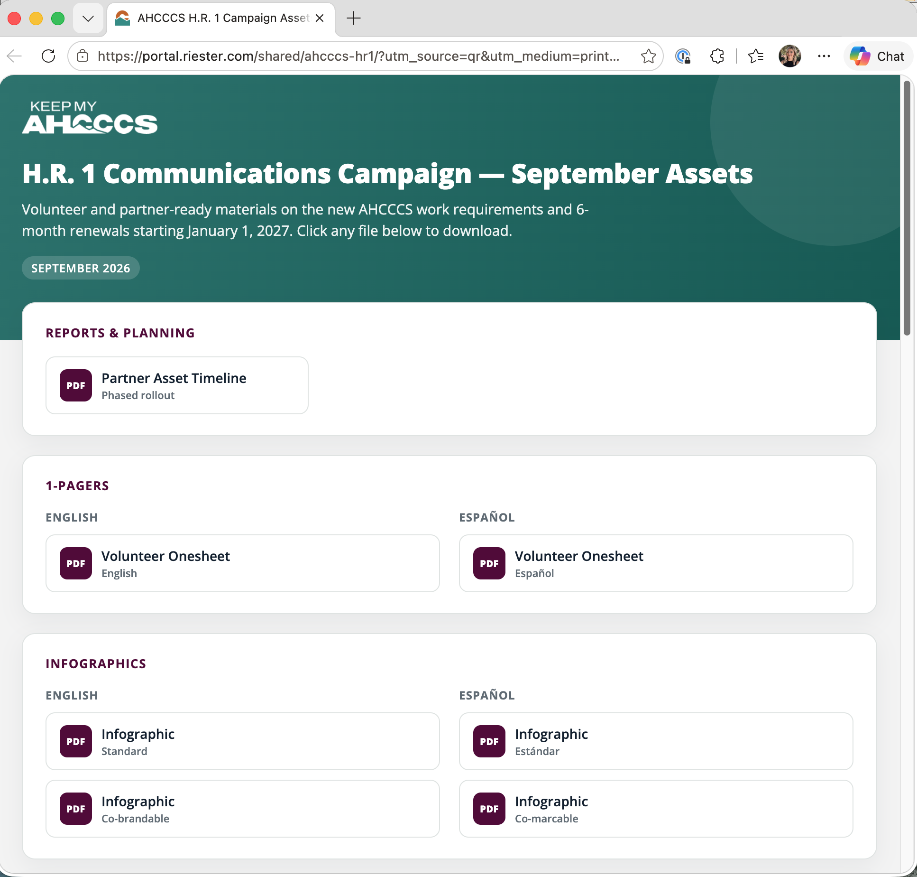

Resources for Your Team
Visit keepmyahcccs.com/partners for up-to-date information, shareable assets and other tools and resources in both English and Spanish.
Click on “Are you a Partner?” on the homepage:

Slide 26
Questions?

